Slide 1
Genomic dissections of inflammatory proteins
On behalf of the SCALLOP/INF1 consortium
https://jinghuazhao.github.io/INF/
22/5/2019

Slide 2
Introduction
There is strong motivation to integrate genomic, proteomic and phenotypic data for biological and clinical insights (Sun et al. 2018, Genz et al 2016, Niewczas et al. 2019).
The focus here is on 12 SCALLOP discovery studies with genomewide association results of 91 Olink/Inflammation proteins – inflammation is vital in immune response and increasingly seen in a range of pathological processes and diseases.

Slide 3
Study information
Study name | Study design |  | Sample size
NSPHS |  | population study Sweden |  | 866
MadCam |  | ulcerative colitis |  | 185
STABILITY |  | atherosclerosis |  | 2,951
STANLEY swe6 |  | bipolar, depression |  | 300
STANLEY lah1 |  | bipolar, depression |  | 344
BioFinder |  | dementia |  | 1,496
RECOMBINE |  | rheumatoid arthritis |  | 860
Estonian Biobank |  | population study Estonia |  | 487
INTERVAL |  | blood donors England |  | 4,902
KORA F4 |  | population study Germany |  | 1,064
ORCADES |  | population isolate Orkney |  | 981
VIS |  | population isolate Croatia |  | 899
Total |  |  |  | 15,335

Slide 4
Olink Proximity Extension Assay (PEA) technology
Multiplex immunoassays that measure 92 proteins across 96 samples simultaneously using only one microliter of serum, plasma, etc.
A pair of oligonucleotide-label(l)ed antibodies (“probes”) are allowed to pair-wise bind to the target protein present in the sample in a homogeneous assay, with no need for washing. When the two probes are in close proximity, a new PCR target sequence is formed by a proximity-dependent DNA polymerization event. The resulting sequence is subsequently detected and quantified using standard real-time PCR.
from https://www.olink.com/data-you-can-trust/technology/

Slide 5
Statistical analysis
Proteins. Rank-based inverse normal transformation.
Genotypes. 1000Genomes, UK10K+1000Genomes or HRC imputed genotypes.
Model. Additive genetic model with adjustment for sex, age, principal components and/or cohort-specific covariates.
Meta-analysis. SNP-based meta-analysis on effect sizes.
Signal identification. Clumping and joint/conditional analysis
Downstream analysis. cis/trans classification is now among the functions and accommodates both PLINK and GCTA results; PhenoScanner was also integrated.
Computing facilities. TRYGGVE with GNU parallel and cardio with SLURM.

Slide 6
Individual-level data analysis for KORA
Mixed successes with pilot on BOLT-LMM and OPG/TNFSF14.
Switch to SNPTEST on transformed measurement ~ age+sex+PC1-PC5, where PCs were derived from a panel of pruned SNPs using PLINK.
Exclusion of six related individuals.
INFO score was compared between SNPTEST and qctool –snp-stats.
Final sample size N=1,064.
Several disruptions on cardio/TRYGGVE and FGF.5 for #SNPs.

Slide 7
Meta-analysis
METAL 2018-08-28 release with TRACKPOSITIONS/CUSTOMVARIABLE.
No GC correction (polygenicity/population stratification) on individual studies.
Effect size-based (as composed to the p-value based counterpart).
Decremental experiments from ADDFILTER N>=30 to N>=10 only to avoid variants with no data.
Furnished in ~ 36hr on TRYGGVE.

Slide 8
Signal identification
There has been recognition in the literature about approximately independent (AI) LD but hardly used; overlap is possible with .ranges files PLINK --clump-range but setup is difficult with GCTA.
To investigate the impact, we conducted in silico experiments w.r.t.,
1KG (built from LocusZoom 1.4 at TRYGGVE and also curated databases at cardio) and UK10K+1KG as LD references.
GCTA –cojo-collinear 0, 0.1, 0.9 –cojo-wind 500, 10000
PLINK –clump-r2 0, 0.1 –clump-kb 500, 1000
Regions in high LD including HLA
SNPs, +indels
The use of AILD blocks
In line with Yengo et al (2018), signals were taken as near-independent (primary + secondary) from GCTA –cojo-slct.

Slide 9
Statistics on AILD blocks
The predefined 1,703 autosomal regions have flanking distances (No of regions) correspondence such that are 250kb (36), 500kb (300) and 10mb (1,701).
Exclude regions in high LD including HLA, giving 1,672 regions.

Slide 10
Annotation by PhenoScanner
PhenoScanner v1.1 (on cardio with chr:pos input) esp. on OPG by Kwan et al. (2014).
PhenoScanner v2 (on cardio with rsid input, esp. after referring to SNPID-rsid correspondence in INTERVAL) results for INF1 as a whole and by proteins.
The latter was complemented with R/MendelianRandomization.
Additional results on IBD, rheumatoid arthritis.

Slide 11
Quality control as with IFN.gamma
The majority of sumstats for each protein were satisfactory.
However, there were a small number (~20) of problematic proteins according to QCGWAS, with which Manhattan plots were produced for each protein from each cohort. It appeared that the total number was a function of MAF, from ~20 at 0.03 to 3 at 0.1.
The QC over IFN.gamma is given below as example.
QCGWAS.
Information from cohort on those proteins links to LLOD.
Exclusion from meta-analysis.
Final Manhattan plot.

Slide 12
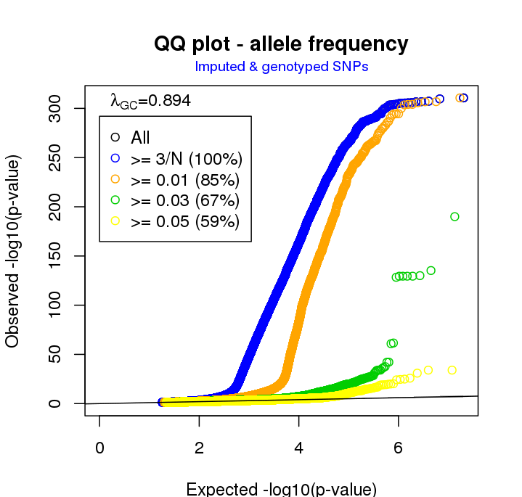
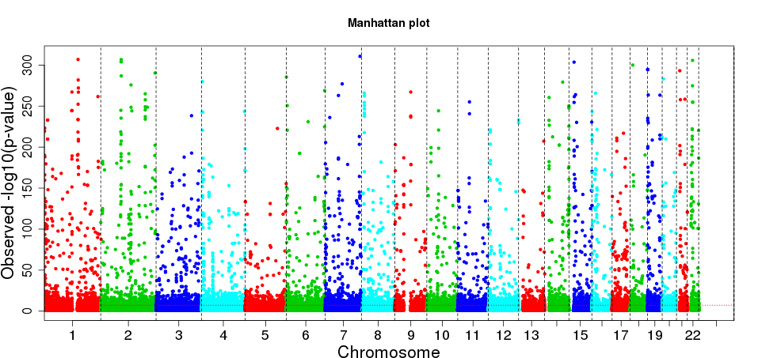
Manhattan (L) and Q-Q (R) plots

Slide 13
Above-LLOD% and exclusion
It turned out
An attempt was made in the study by using llod/2.
Manhattan plots (excessive number of significant hits) closely related to this.
Although higher MAF cutoffs could do away with busy Manhattan plots, it is unusual to do so and the associate proteins with low >LLOD% were discarded.

Slide 14
Busy Manhattan plots and above-LLOD%
Protein | % | Protein (continued) | % (continued)
L.15RA | 0.841 | IL13 | 0.062
ST1A1 | 0.808 | IL.20RA | 0.057
MCP.3 | 0.804 | IL.24 | 0.051
FGF.5 | 0.652 | IL.20 | 0.046
AXIN1 | 0.425 | NRTN | 0.039
IL.17A | 0.380 | ARTN | 0.035
IL.17C | 0.369 | IL.1.alpha | 0.025
IL4 | 0.171 | IL.2RB | 0.023
IL5 | 0.162 | IL33 | 0.014
IL.10RA | 0.149 | IFN.gamma | 0.007
TNF | 0.096 | TSLP | 0.005
LIF | 0.064 | IL.22.RA1 | 0.003

Slide 15
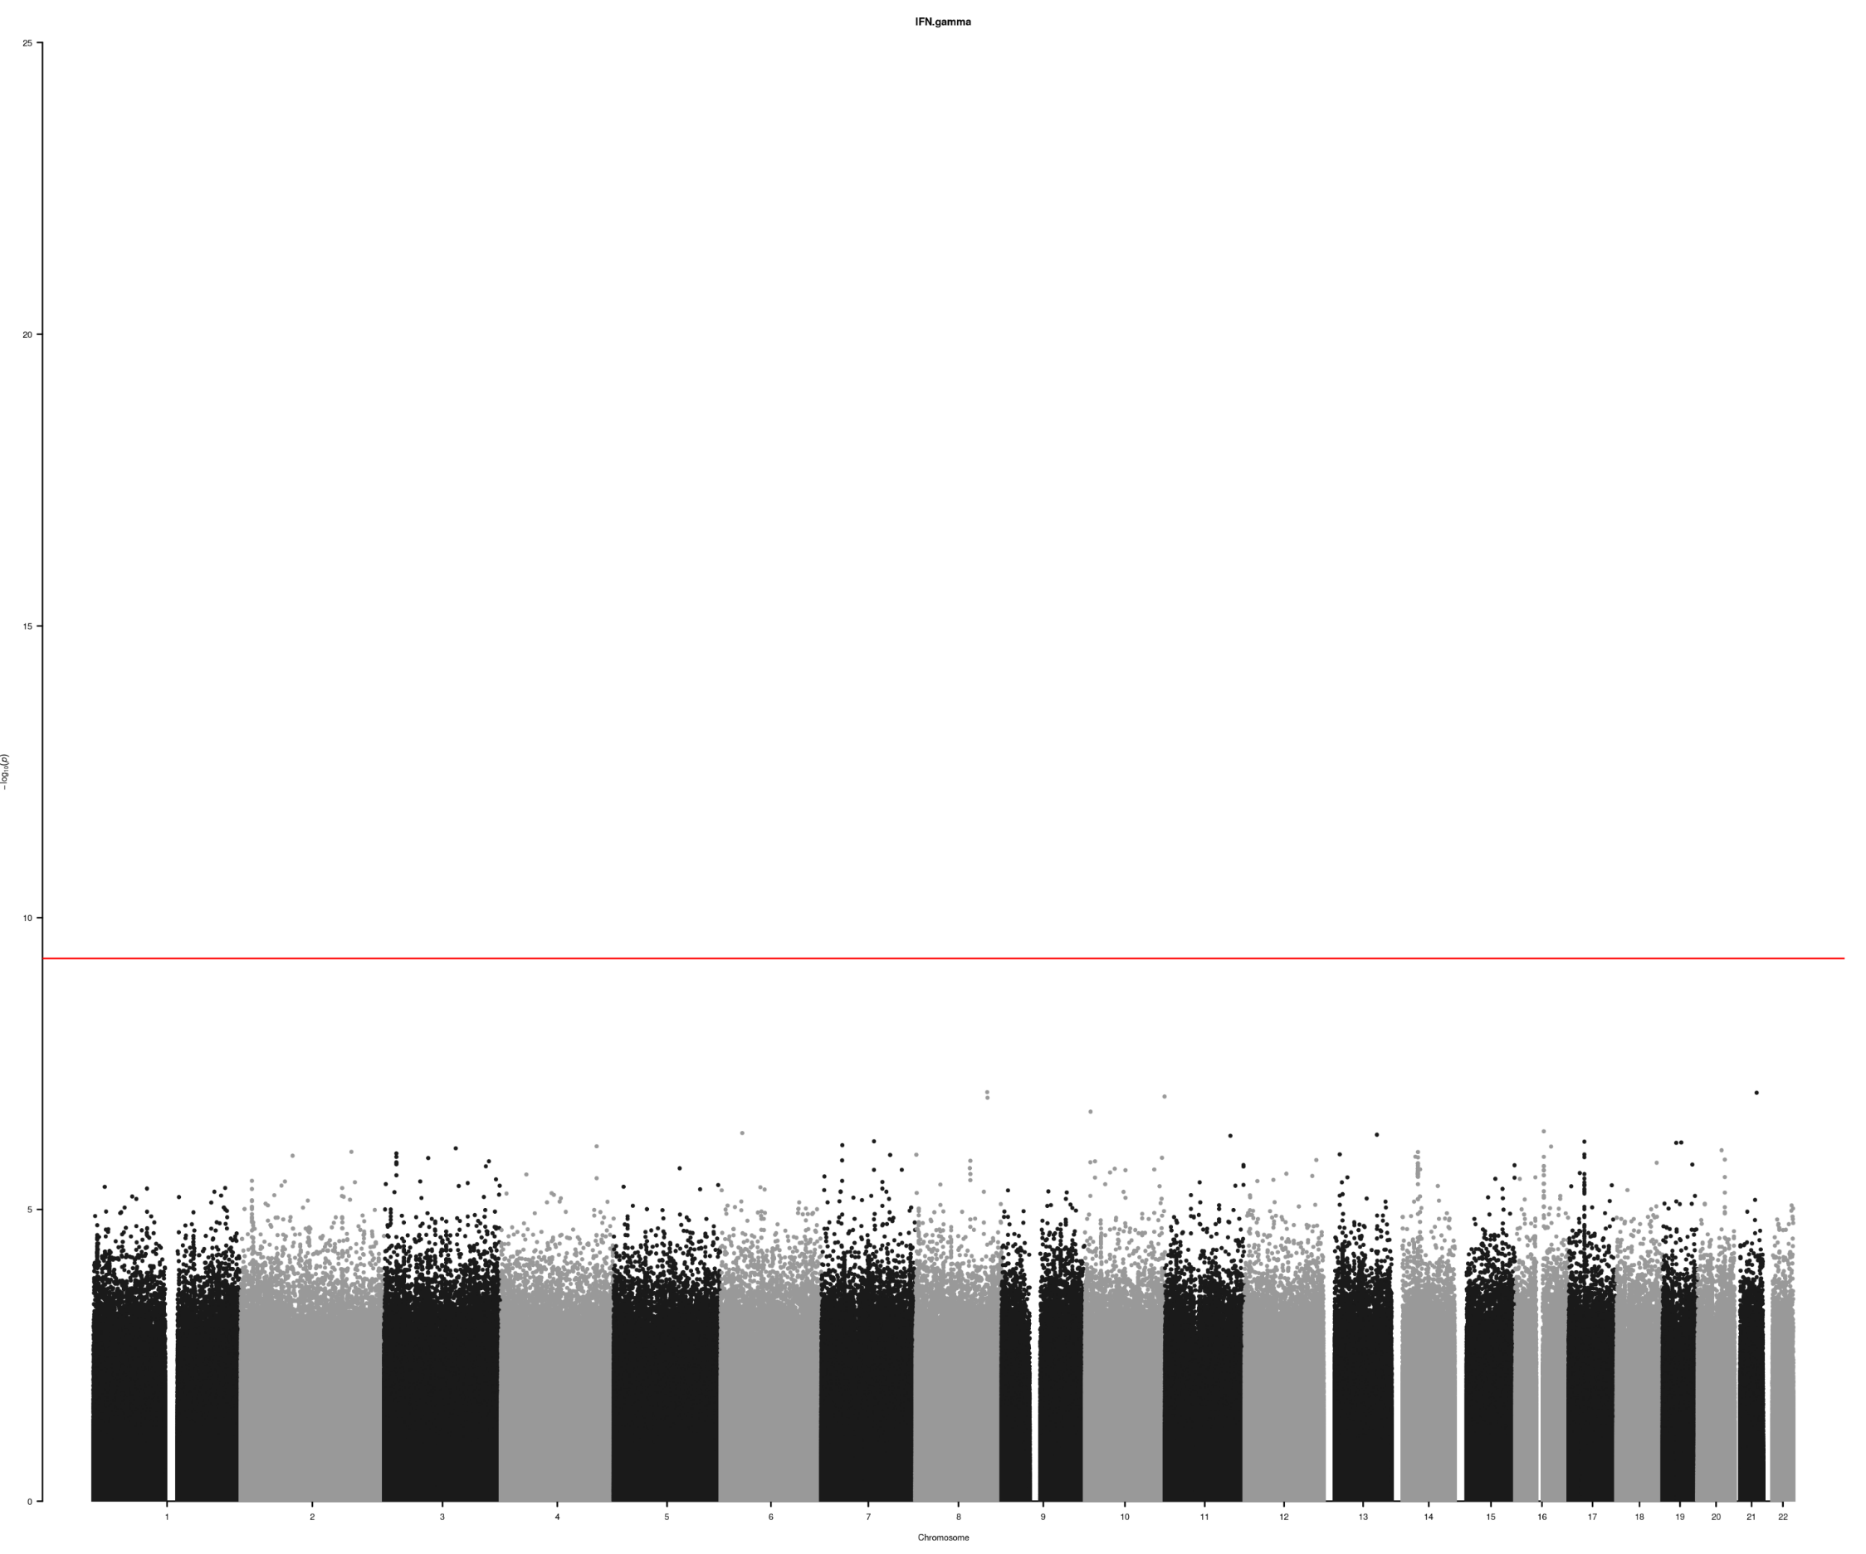
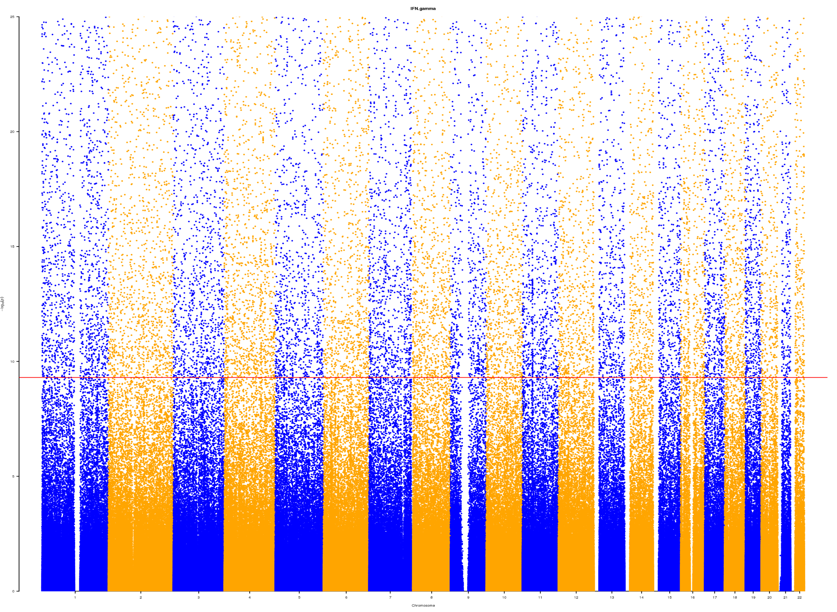
IFN.gamma from >1,000 signals (L) to none (R)

Slide 16
Results
Manhattan, Q-Q, LocusZoom (cis regions) and forest plots.
A general sense of options for identification of near-independent signals from contrast between 1KG, UK10K+1KG (INTERVAL genotypes) compared to INTERVAL.
cis/trans classification of signals.
Replication of findings on OPG (Kwan et al. 2014) through PhenoScanner v1.1. Further work is onging with v2 outputs.
Parellel effort on colocalisation anslysis.

Slide 17
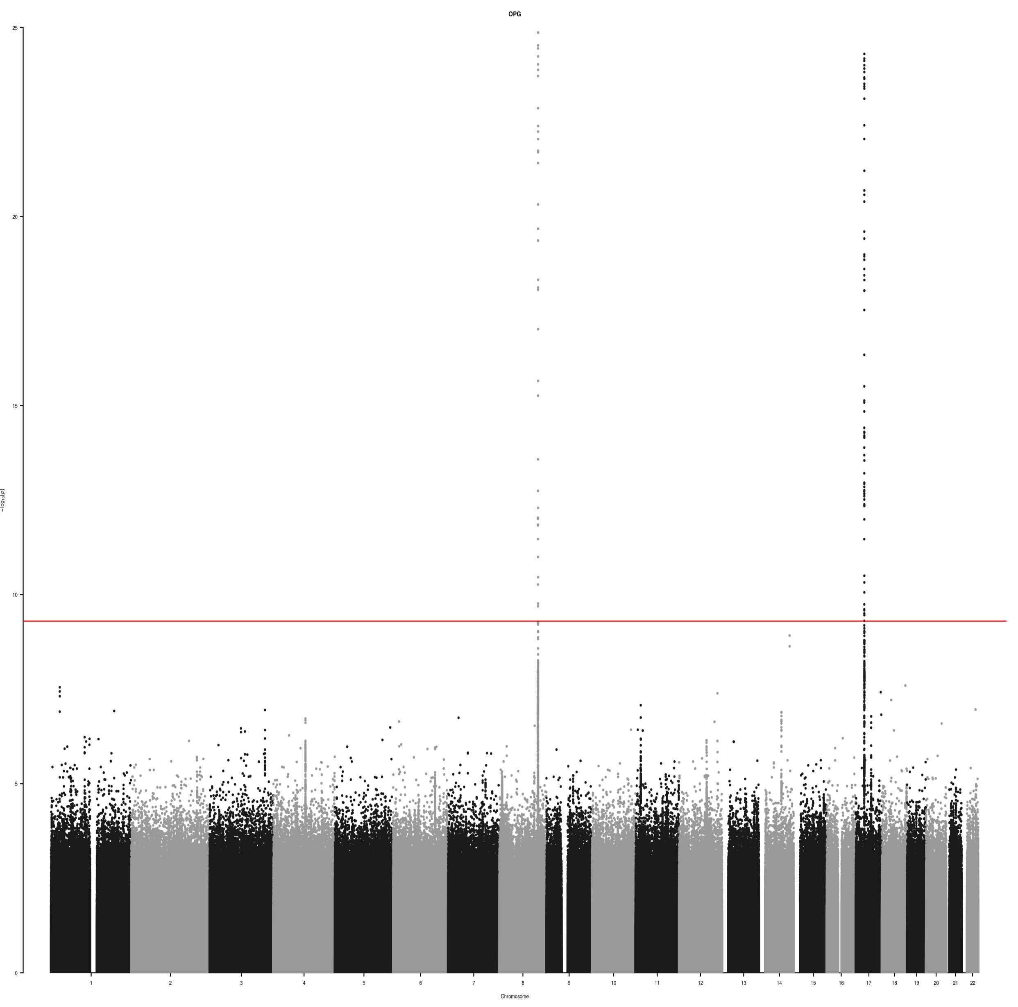
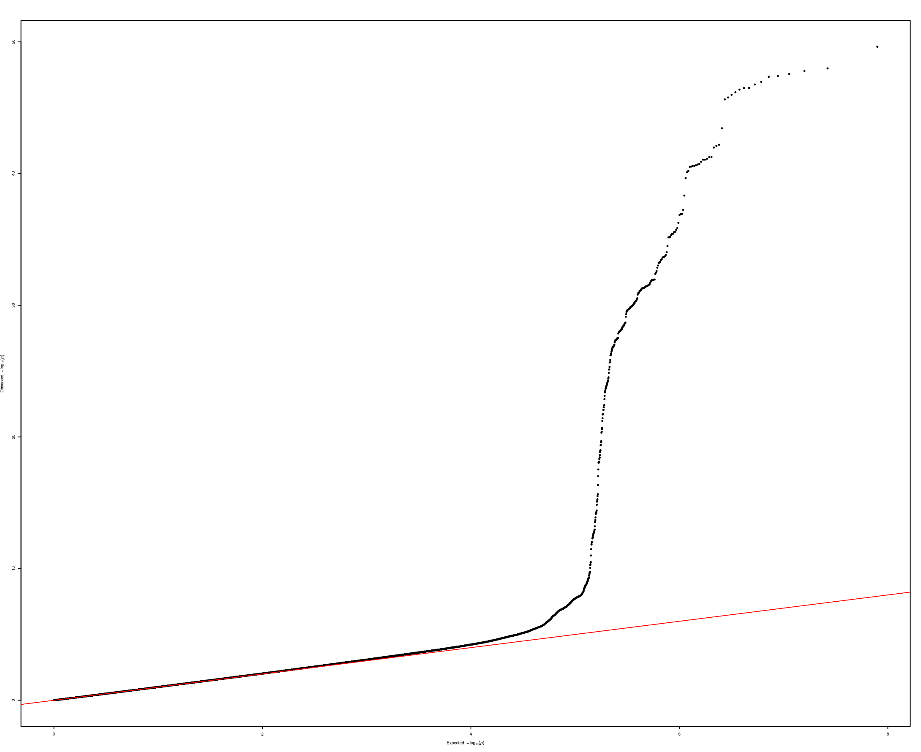
Manhattan (L) and Q-Q plots (R) for OPG

Slide 18
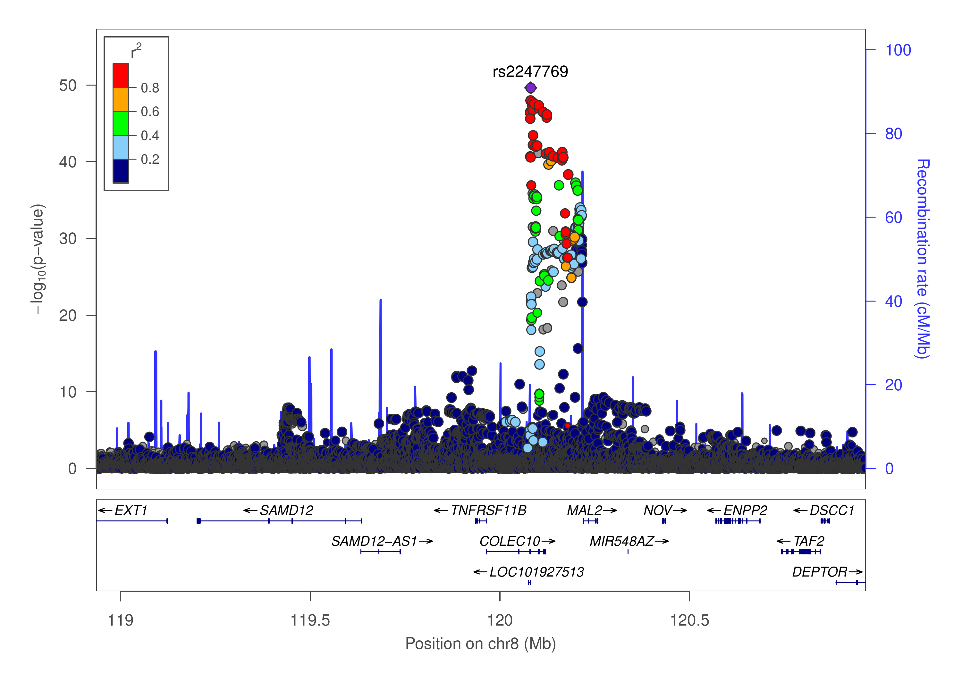
Regional plot (OPG, chr8)

Slide 19
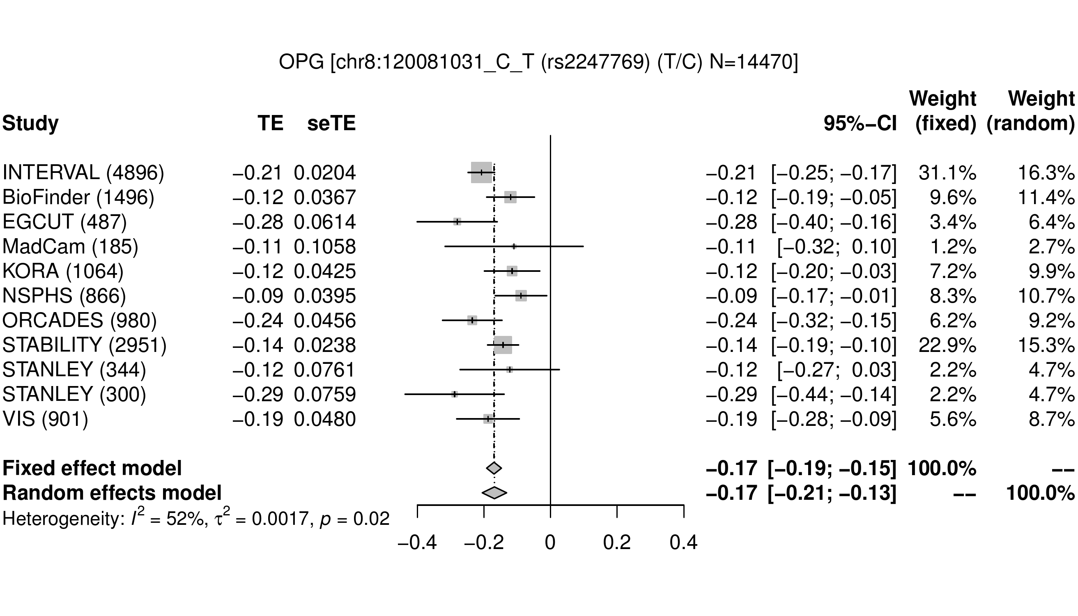

Slide 20
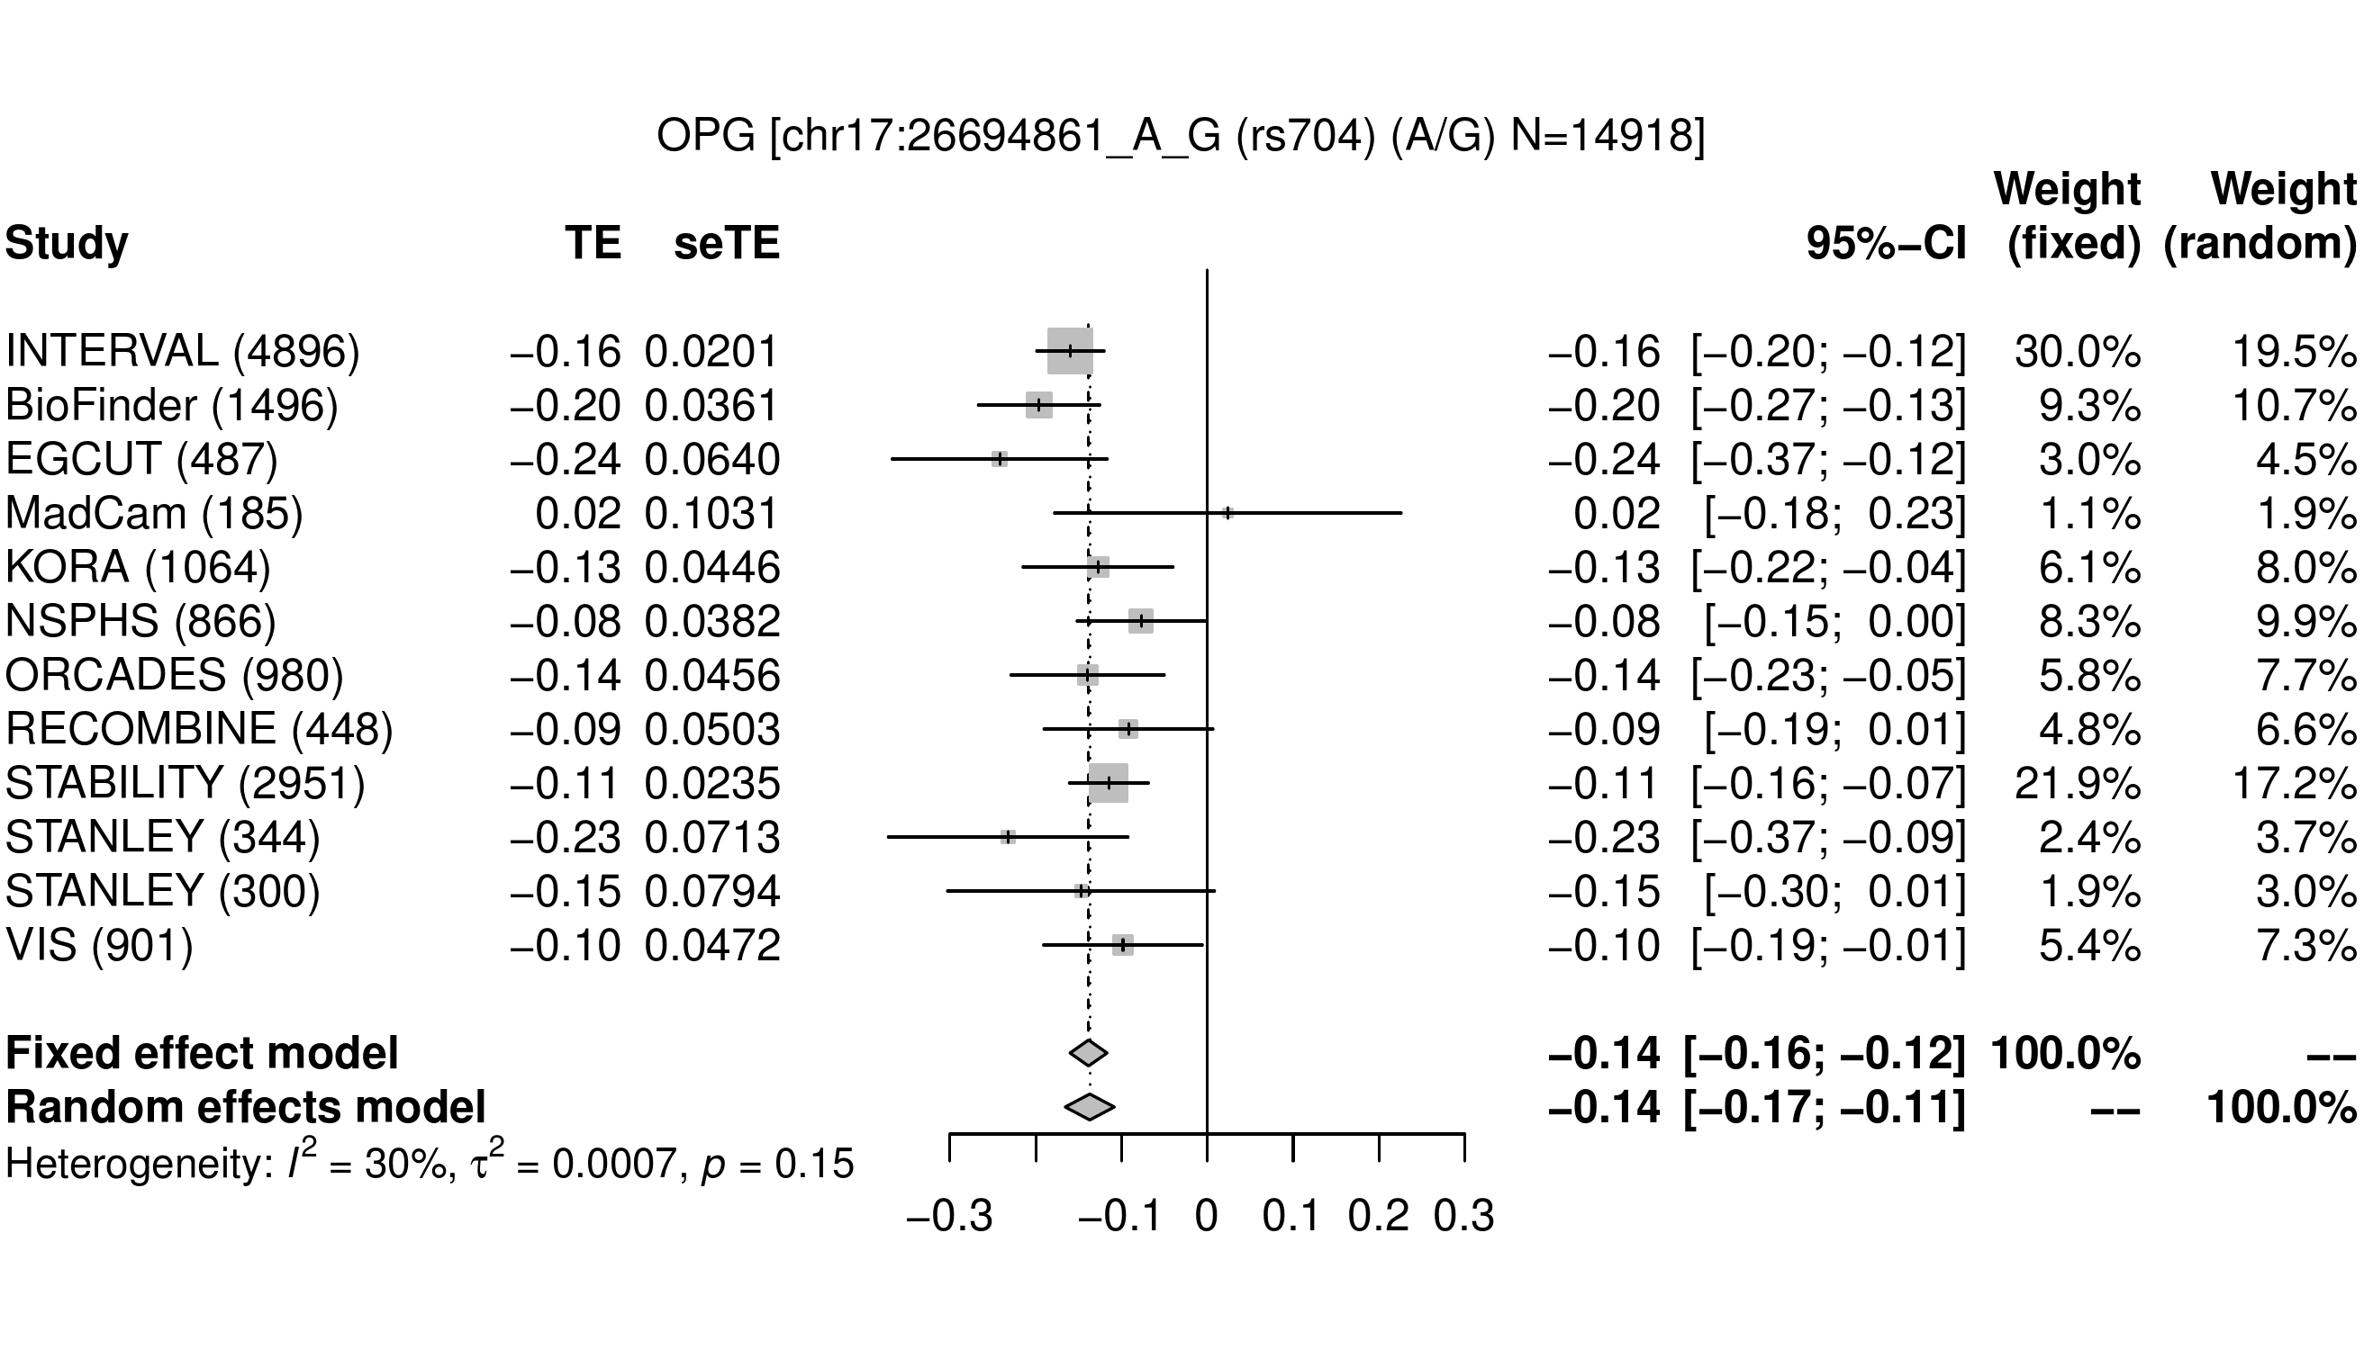

Slide 21
Comparison with Kwan et al. (2014)
The chromosome 8 locus here is ~200kb upstream.
Same SNP for the trans signal quoting Kwan et al. (2014). “The chromosome 17 locus identified in the sex-combined meta-analysis encompasses multiple genes, including FLJ40 504, POLDIP2, TMEM97, MIR4723, VTN, IFT20, SARM1, TNFAIP1, SLC46A1, TMEM199, and SEBOX. The most significant SNP in this locus (rs704) encodes a possibly damaging (predicted by PolyPhen2) missense mutation in the VTN gene. Moreover, eQTL analyses showed that the SNP was significantly associated with TMEM199 expression in pancreas and whole bone, as well as TMEM97 expression in whole blood. The low RegulomeDB score of the SNP also suggested that the SNP has important regulatory functions”.

Slide 22
Findings from in silico experiment
1. More signals were introduced by indels and 18 in case of SNPs vs SNP+indels; 2. default GCTA --cojo-collinear and --cojo-wind parameters did quite well in numbers; 3. Although it looks close, PLINK –clump-r2 0/GCTA --cojo-collinear 0, 0.1 produces considerably less signals compared to --cojo-collinear 0.9 yet moderate changes in LD window have less impact than the reference panel; 4. PLINK --clump gives more signals than GCTA –cojo; 5. Specification of sliding LD windows disregarding AILD patterns in clumping gives 53 additional signals; 6. Thanks to the larger sample size and perhaps greater variant number, INTERVAL as LD reference leads to more signals than 1000Genomes; 7. Summary statistics from larger sample size gives more signals; 8. Unpruned results are likely to give more cis signals but this is subject to scrutiny perhaps on individual cases.
See https://github.com/jinghuazhao/INF/blob/master/cardio/clump-cojo.md

Slide 23
Near-independent signals via AILD
Algorithms
Form AILD blocks with INTERVAL UK10K+1KG imputed data, involving specific variants.
Tag sumstats with AILD blocks.
Overlap regions with GWAS sumstats containing signals to 233 protein-region pairs.
PLINK –clump-r2 0.1 and/or GCTA --cojo-collinear 0.9 (no –cojo-r2 yet).
Regional plots specific to these, esp. any singleton indels.
Significantly reduced computing times for GCTA from ~10 days to <1 day on cardio.
Notably, INTERVAL and INF1 share similarity in both number of signals in cis/trans classification.

Slide 24
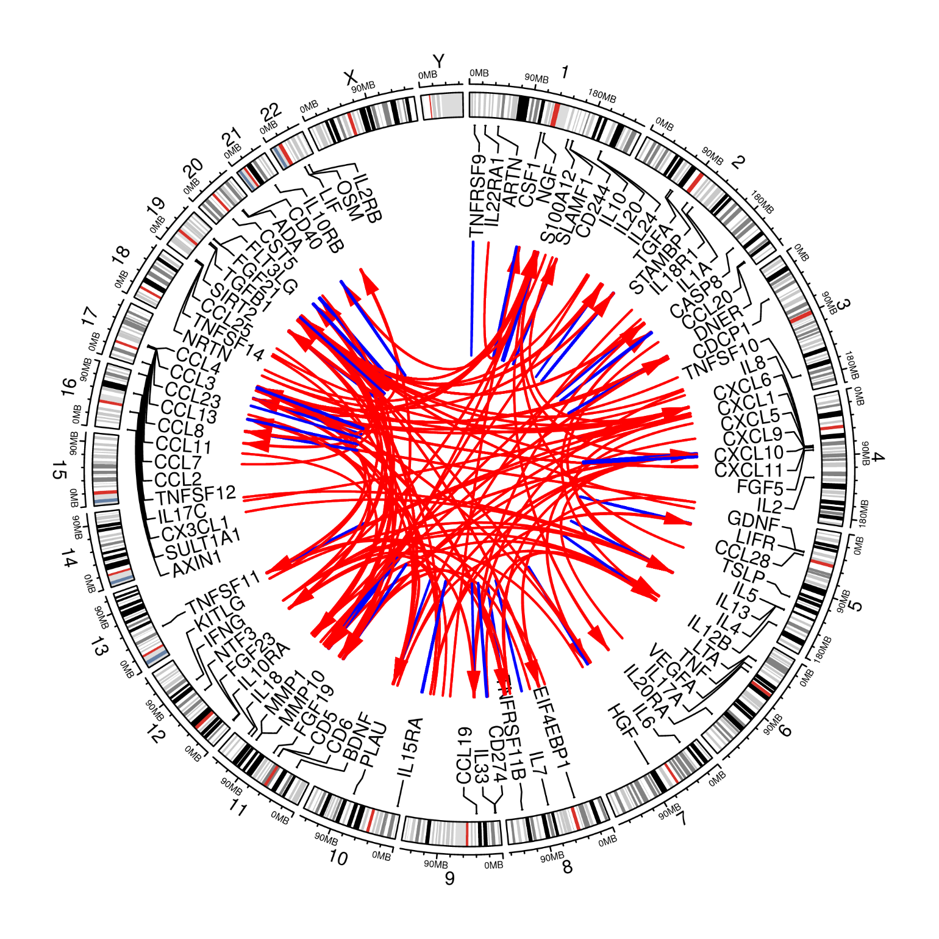
375 (SNP+indel) Signals
355 primary+20 secondary signals.
Proteins |  | Signals
only cis pQTLs |  | 12
only trans pQTLs |  | 14
both cis and trans |  | 43
no pQTL |  | 22
220 cis/155 trans signals, excluding 35 signals from regions in high LD.

Slide 25
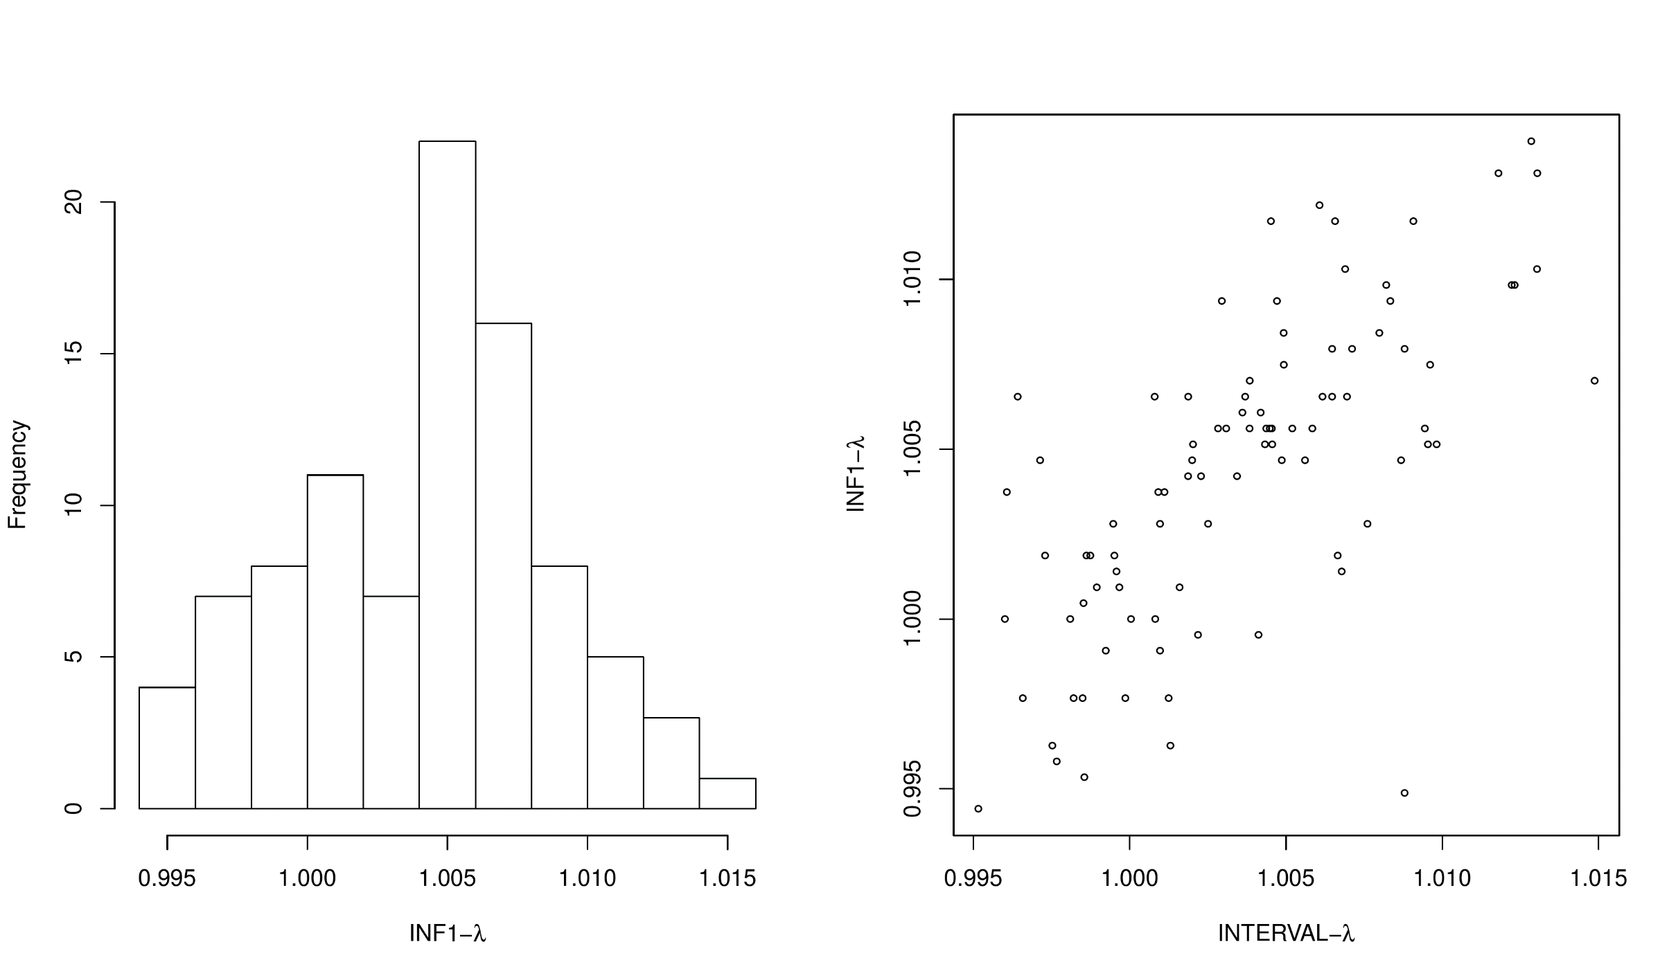
λGC

Slide 26
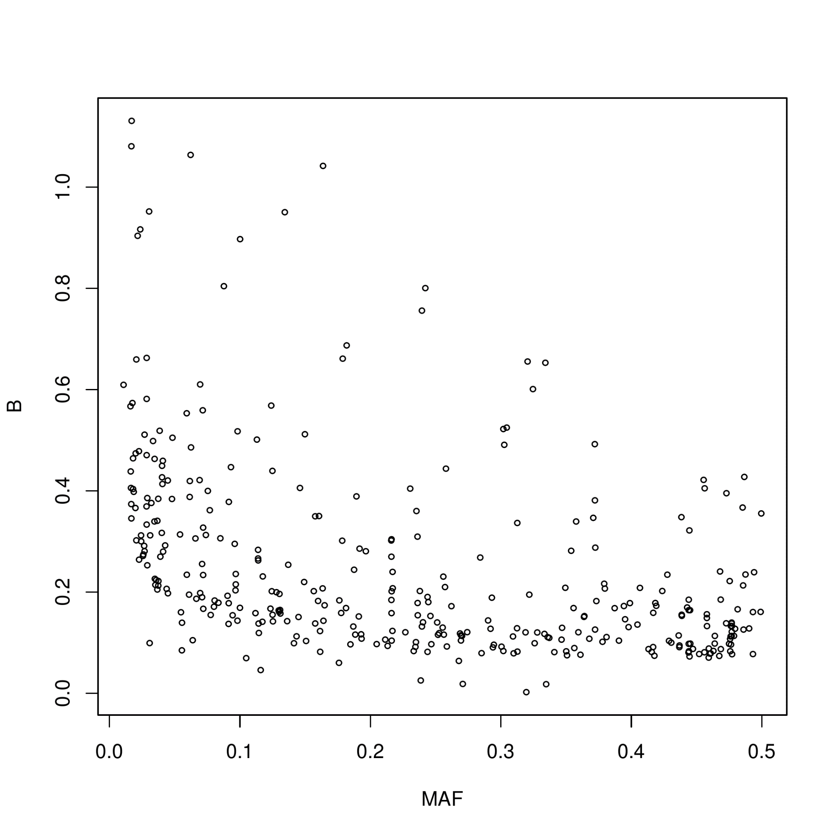
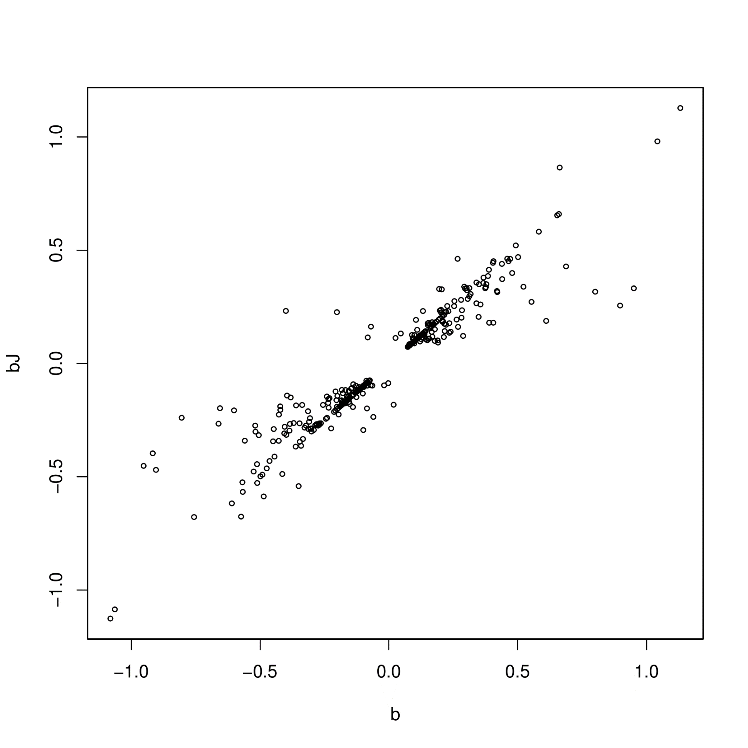
Effect size -- MAF (L) and b/bJ (R, r=0.93)

Slide 27
Summary
The AILD-based analysis reduced the uncertainty in LD-window specification. The specific findings on OPG (and also TNFSF14, IL12B, not shown) served as good positive control to replicate earlier work but on a greater scale. In general, it will corroborate with related work on generic evidence (Sun et al. 2018) as with inflammation-specific aspects on the SomaScan panel (Niewczas et al. 2019).
The website https://jinghuazhao.github.io/INF/ provides information which will also facilitate analysis from other panels in the SCALLOP consortium.
Ongoing work include eQTL/MR.

Slide 28
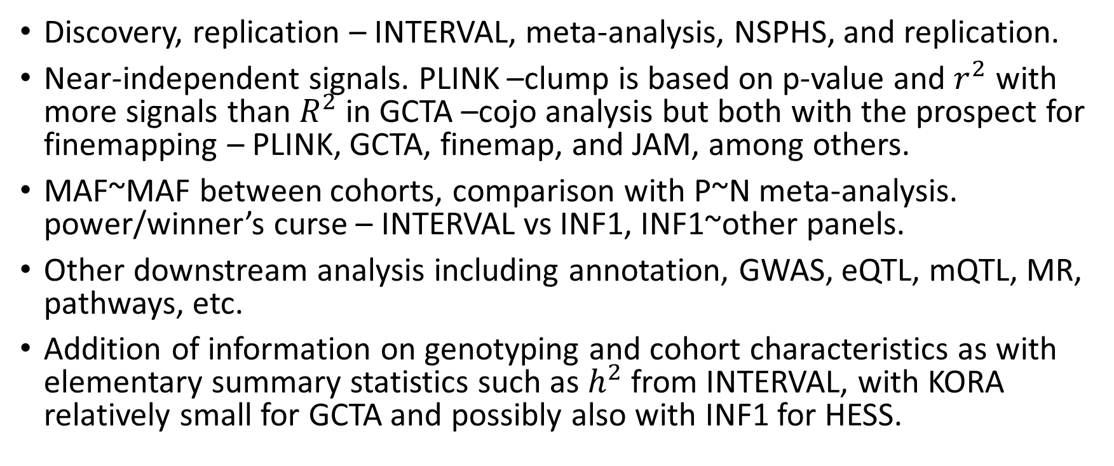
Elements of the analysis
Discovery, replication – INTERVAL, meta-analysis, NSPHS, and replication.
Near-independent signals. PLINK –clump is based on p-value and $r^{2}$ with more signals than $R^{2}$ in GCTA –cojo analysis but both with the prospect for finemapping – PLINK, GCTA, finemap, and JAM, among others.
MAF~MAF between cohorts, comparison with P~N meta-analysis. power/winner’s curse – INTERVAL vs INF1, INF1~other panels.
Other downstream analysis including annotation, GWAS, eQTL, mQTL, MR, pathways, etc.
Addition of information on genotyping and cohort characteristics as with elementary summary statistics such as $h^{2}$from INTERVAL, with KORA relatively small for GCTA and possibly also with INF1 for HESS.

Slide 29
References
Ganz P, et al. (2016). Development and risk score for based risk score for cardiovascular outcomes among patients with stable coronary heart disease. JAMA 315:2532-41
Kwan JSH, et al. (2014). Meta-analysis of genome-wide association studies identifies two loci associated with circulating osteoprotegerin levels. Hum Mol Genet 23(24): 6684—93.
Niewczas MA, et al. (2019). A signature of circulating inflammatory proteins and development of end-stage renal disease in diabetes. Nat Med https://doi.org/10.1038/s41591-019-0415-5
Sun B, et al (2018). Genomic atlas of human plasma proteme. Nature 558: 73-9.
Yengo L, et al. (2018). Meta-analysis of genome-wide association studies for height and body mass index in ∼700 000 individuals of European ancestry. Hum Mol Genet 27:3641–3649

Slide 30


Acknowledgements
CEU support team and facilities on HPC/cardio.
Jimmy, Adam, Bram.
IT and TRYGGVE.
Lasse, Anders, study PIs, analysts.

Slide 31
Landmarks
14/5/19 – AILD results including PhenoScanner v2.
9/5/19 – BHF poster on cis/trans signals and IL.12B.
27/3/19 – cross-reference with INTERVAL on INTERVAL genotype data, which showed great similarity with INF1, esp. w.r.t. cis signals.
8/3/19 – Recognition of MAF cutoff on IFN.gamma, IL.22.RA1, TSLP.
29/11/18 – 22 proteins with busy Manhattan plots.

